Slide 1
Brain Machine Interface (BMI) with UI-Aware Controller
Neuralink, US 11630516, 12/27/2021
3/20/2024

Slide 2
Outline
Goal: Introduce methods for interpreting signals from a brain machine interface (BMI) and methods for adjusting implanted or wearable BMI device
Embodiments:
General Views of BMI decoder
BMI with UI-Aware Controller flowchart
UI-Aware Controller flowchart
Interpret Signals from BMI
Adjusting a BMI Device

Slide 3
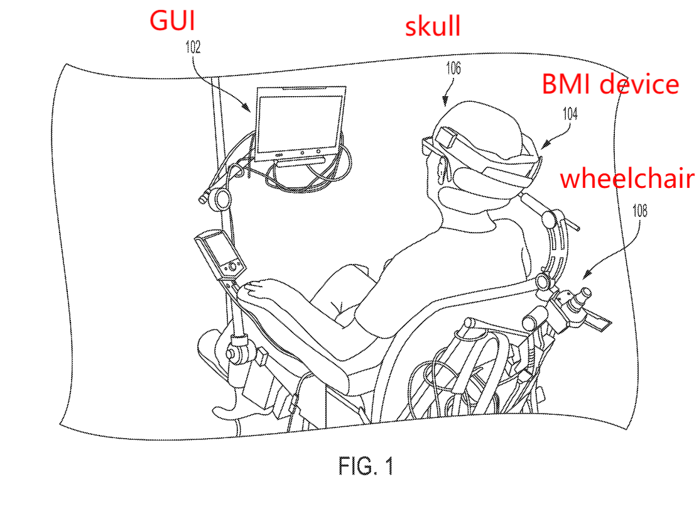
General View

Slide 4
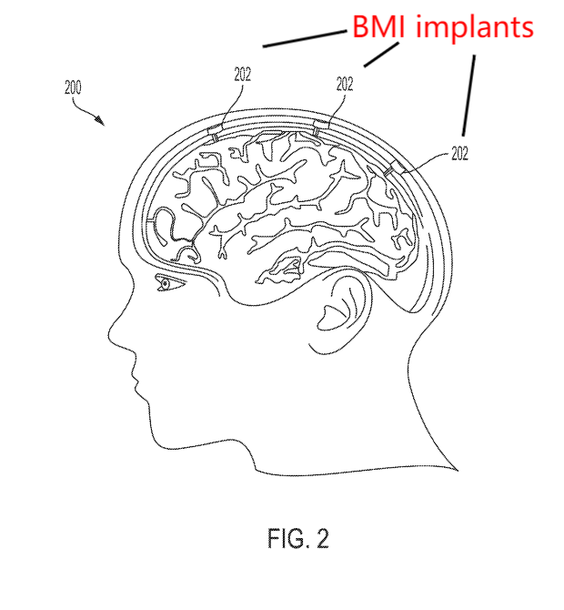
3 implants in cranium

Slide 5
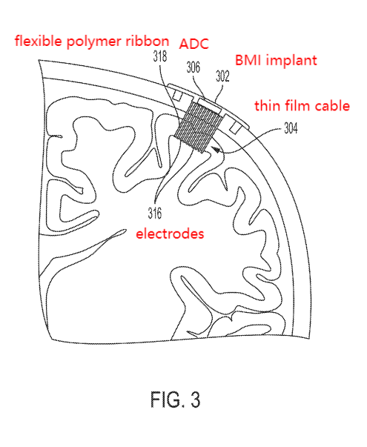
Cross section view of implanted electrodes

Slide 6
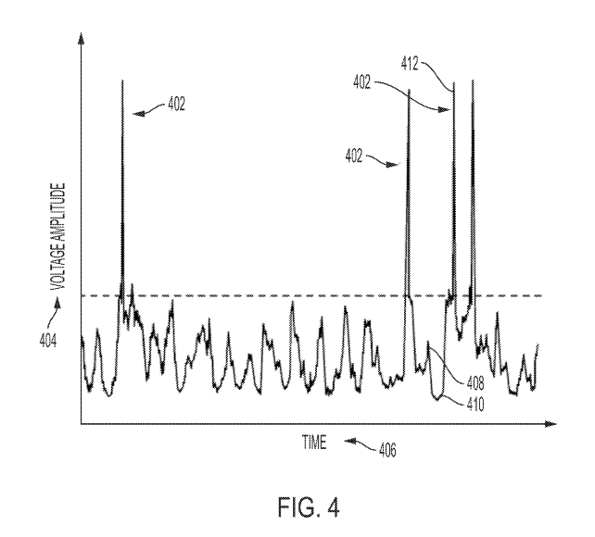
Voltage vs Time graph

Slide 7
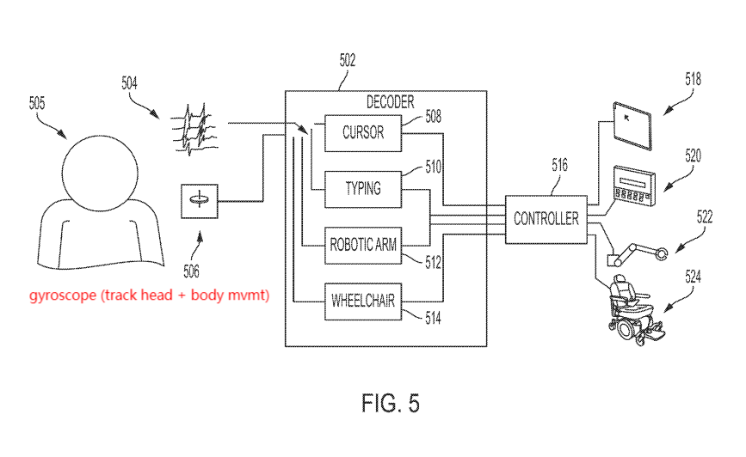
BMI decoder general flowchart

Slide 8
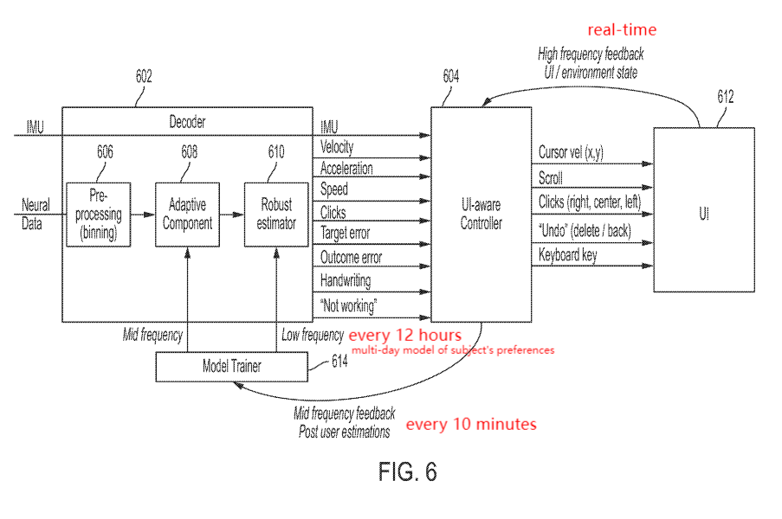
BMI Decoder + UI-Aware Controller
models to translate signals to commands
estimate condition from neural data
e.g., frequency-based

Slide 9
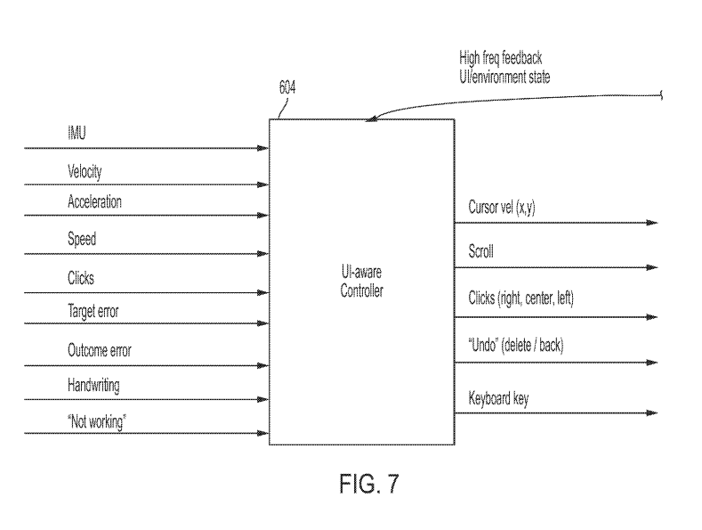
UI Aware Controller
“aware of”:
Translated neural signals from BMI decoder
e.g. type of activity (keyboard typing), environment of activity (UI, location of cup on table), activity history (recently opened)
External information feedback
e.g. software or OS data
Unstructued information
e.g. audio from microphone, video from camera

Slide 10
UI Aware Controller
Can adjust commands based on:
neural signals, feedback, or environment
repeated behavior of subject
adjust efficiency of data

Slide 11
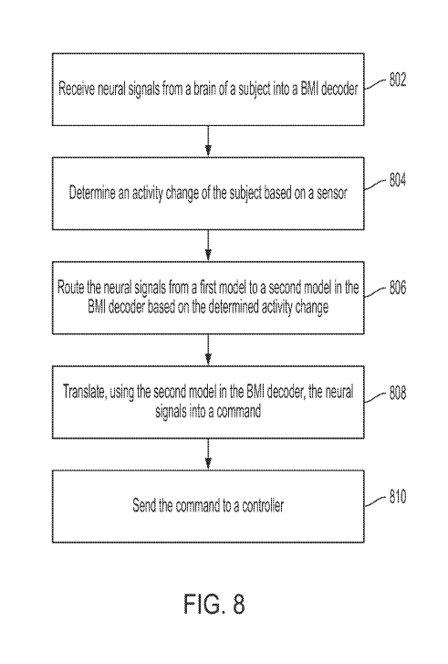
Interpreting Signals on BMI
signal transition

Slide 12
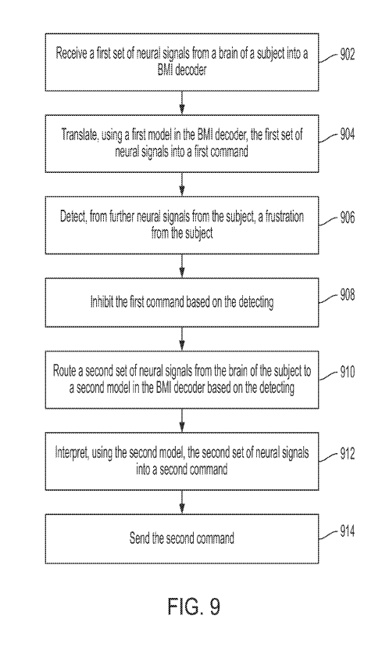
Interpreting Signals on BMI (special case: when user is frustrated)
e.g. repeated backspaces
disable typing on keyboard

Slide 13
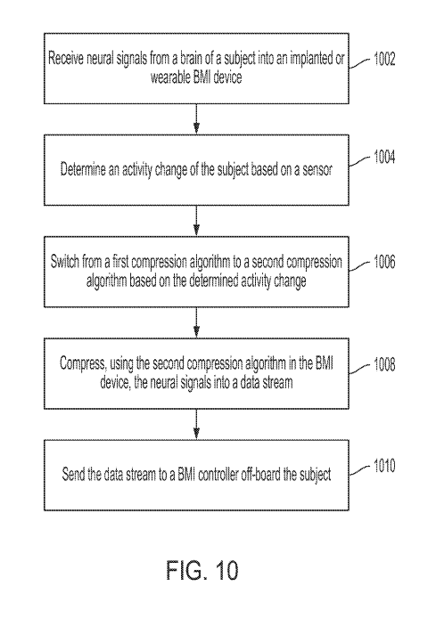
Adjusting BMI device

